Slide 1














ALY6140: PYTHON & ANALYTICS SYSTEMS TECHNOLOGY
UNDERSTANDING SOCIAL DEMOGRAPHICS AND INCOME LEVELS

Slide 2

OUR TEAM MEMBERS
HARSH ANADKAT
OWAIS BAIG
ROHITH JOGINAPALLY
SUDINDRA KARKERA

Slide 3

INTRODUCTION: EXPLORE THE RELATIONSHIP BETWEEN SOCIAL DEMOGRAPHICS AND INCOME USING THE ADULT DATASET.
Goals of the Project:
Recognize key factors influencing income levels.
Develop predictive models for income based on demographic variables.
Questions to Investigate:
Impact of social and demographic variables on income.
Predictive ability of individual attributes on income levels.
Role of education, occupation, race, and gender in income differences.
Geographic influence on income and its use in predictive models.

Slide 4

METHODS USED IN ANALYSIS: ANALYTICAL APPROACH
Exploratory Data Analysis (EDA):
Thorough exploration of data: Understanding distribution, correlations, and trends.
Summary statistics: Identifying central tendencies and variations in key variables.
Correlation analysis: Identifying predictors of income using data visualization like histograms, box plots, and bar charts.
2. Feature Engineering:
Handling missing values: Replacing '?' with 'NA' and removing entries.
Target variable encoding: Converting 'income' into binary ('<=50K' and '>50K') for classification.
Scaling and encoding: Ensuring data uniformity and suitability for machine learning using techniques like one-hot encoding.
3. Machine Learning Models:
Algorithm selection: Using logistic regression, decision trees, random forests, and support vector classifiers for income prediction.
Model evaluation: Assessing model performance with F1-score, accuracy, precision, and recall metrics.
Model validation: Validating models using cross-validation and train-test splits to avoid overfitting and enhance predictive reliability.

Slide 5
EXPLORATORY DATA ANALYSIS (EDA)
Data Extraction:
Overview of the Adult dataset containing demographics and socioeconomic characteristics.
Variables include age, workclass, education, marital status, occupation, race, sex, hours worked per week, income, and native country.
Data Cleanup:
Handling missing values: Replaced '?' with 'NA' and removed entries to ensure data integrity.
Encoding target variable: Converted 'income' into binary form ('<=50K' and '>50K') for classification.

Slide 6



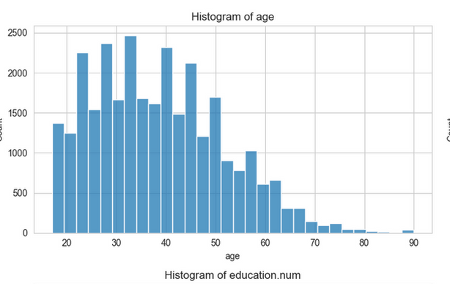
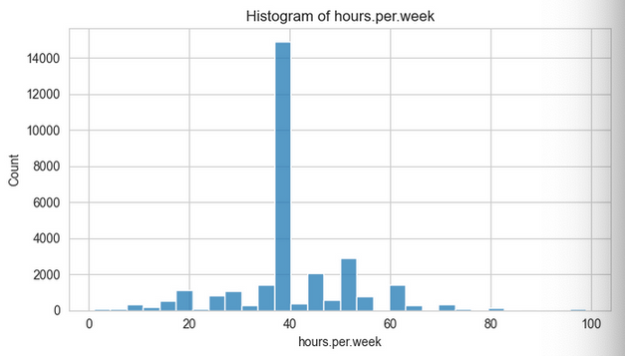
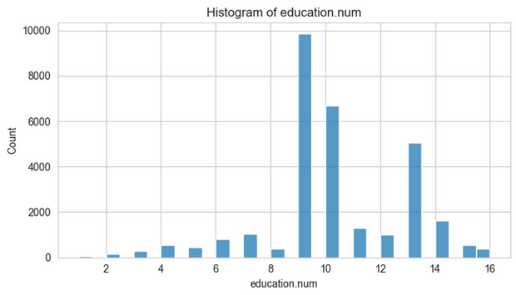
DATA VISUALIZATIONS: HISTOGRAMS FOR NUMERICAL DATA ANALYSIS
Age Distribution
Work Hour
Graph
Education Impact
04

Slide 7


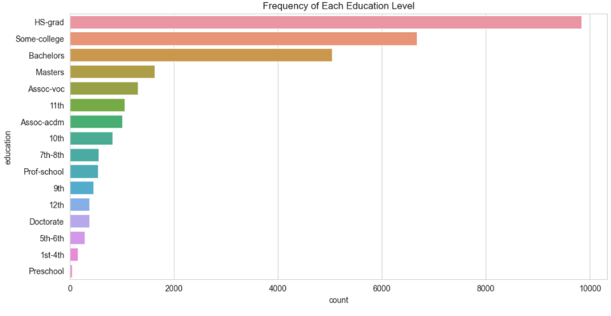
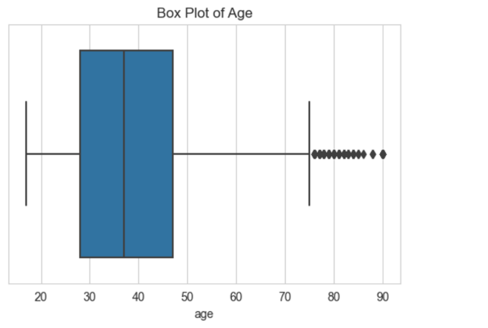
BAR CHART AND BOX PLOT FOR CATEGORICAL DATA ANALYSIS
BAR CHART FOR EDUCATION LEVEL DISTRIBUTION
BOX PLOT ANALYSIS FOR AGE DISTRIBUTION

Slide 8
PREDICTIVE MODELS
Encoding Categories: We converted categories into numbers for better machine understanding.
Scaling Numbers: We standardized numerical data to ensure uniform learning
Data Split: We divided data for training (80%) and testing (20%) to assess model performance.

Slide 9
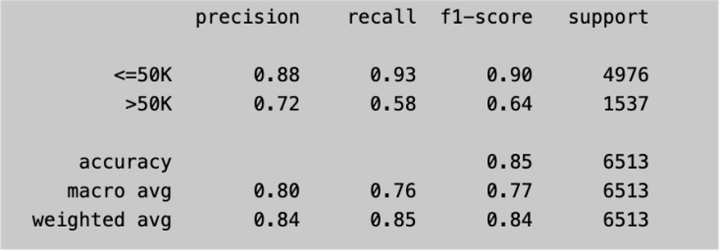
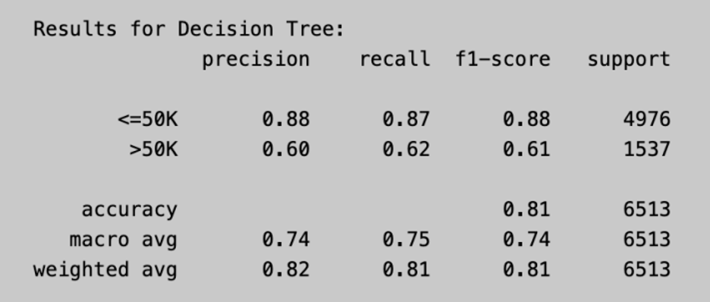
LOGISTIC REGRESSION
DECISION TREE CLASSIFIER

Slide 10
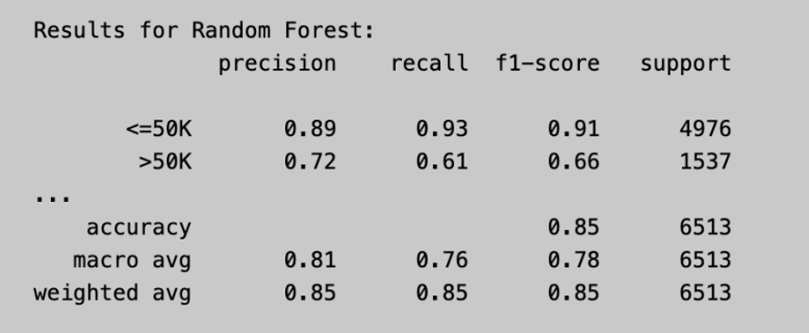
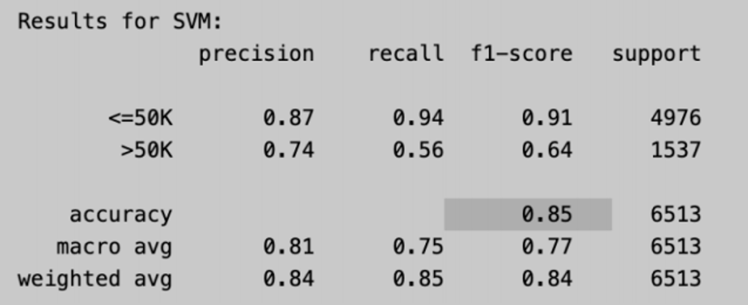
RANDOM FOREST CLASSIFIER
SUPPORT VECTOR MACHINE

Slide 11

CONCLUSION
We measured how well each model did by looking at accuracy, precision, recall, and F1-score. Here's what we found:
Logistic Regression: Did well overall, especially for predicting lower incomes, but struggled with higher incomes.
Decision Tree: Also good at predicting lower incomes, but not so great with higher incomes.
Random Forest: Did really well at predicting lower incomes and was okay with higher incomes.
Support Vector Machine: Did well with lower incomes but had some trouble with higher incomes
RANDOM FOREST DID THE BEST JOB OVERALL, ESPECIALLY WITH PREDICTING HIGHER INCOMES, WHICH ARE HARDER TO PREDICT ACCURATELY.

Slide 12
THANK YOU VERY MUCH!

